Slide 1
EHSAN COLLEGE OF ENGG FARAH MATHURA
NAME- ANUJ VERMA
ASST. PROFESSOR
SUBJECT NAME –BUILDING MATERIAL AND COSTRUCTION

Slide 7
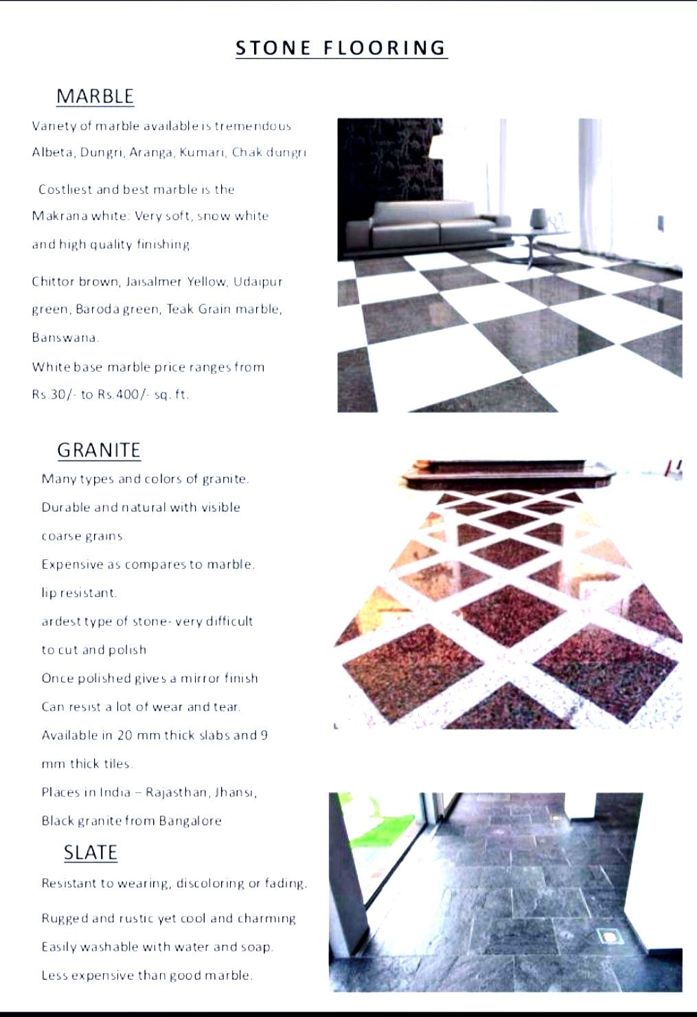

Slide 11
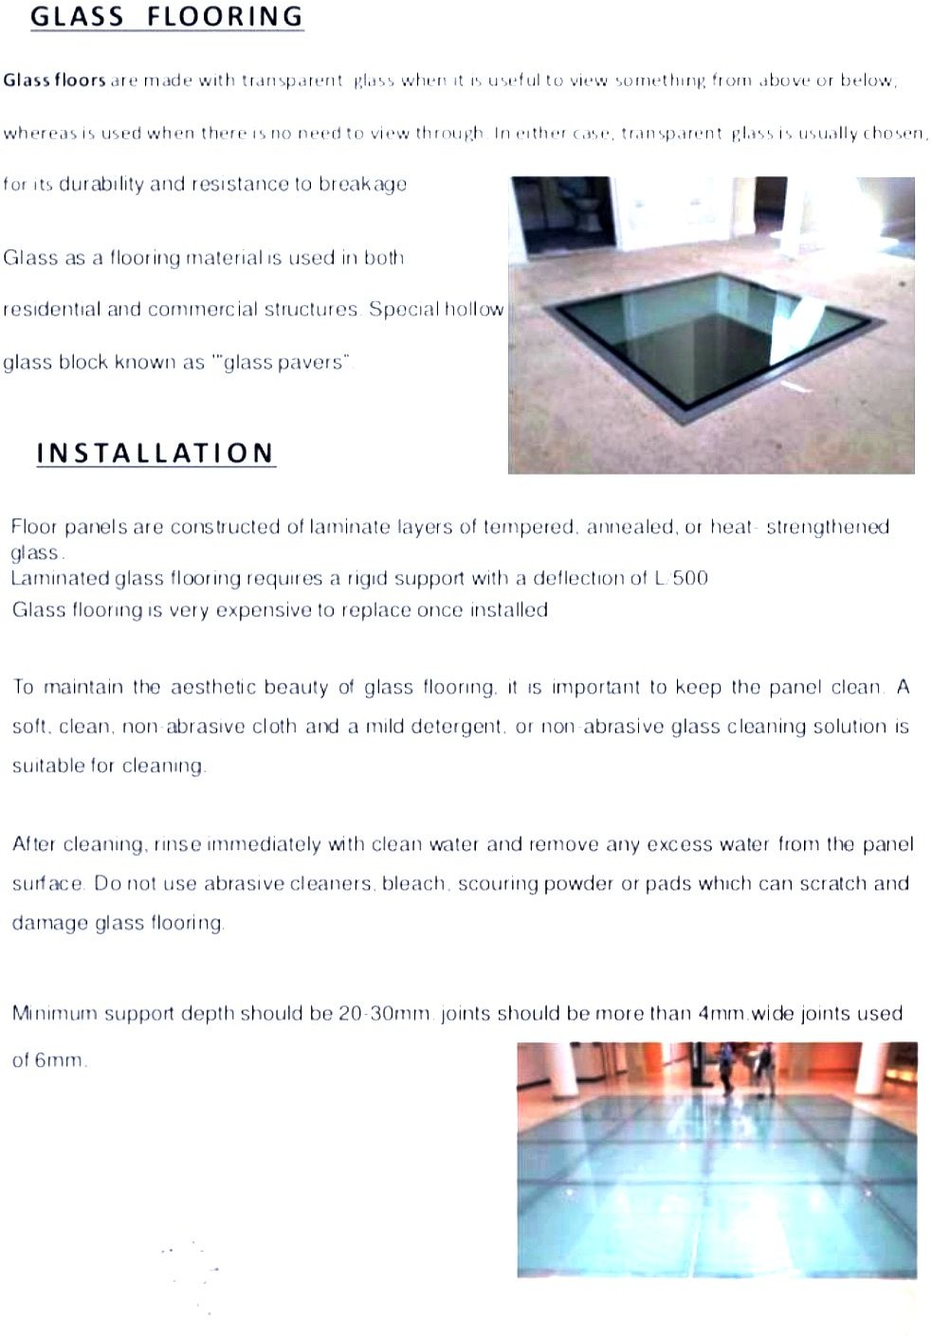

Slide 14
